Slide 1
Body-Based Augmented Reality Feedback During Conversations
Henning Pohl

Slide 2
Notes
Each presentation is scheduled for a 15-minute presentation slot, with 10 minutes for presentation and 5 minutes for questions.

Slide 3

Motivation
Seeming distracted in conversational situations is just rude
Notes:
https://www.pexels.com/video/woman-feeling-upset-on-the-guy-3709168/

Slide 4
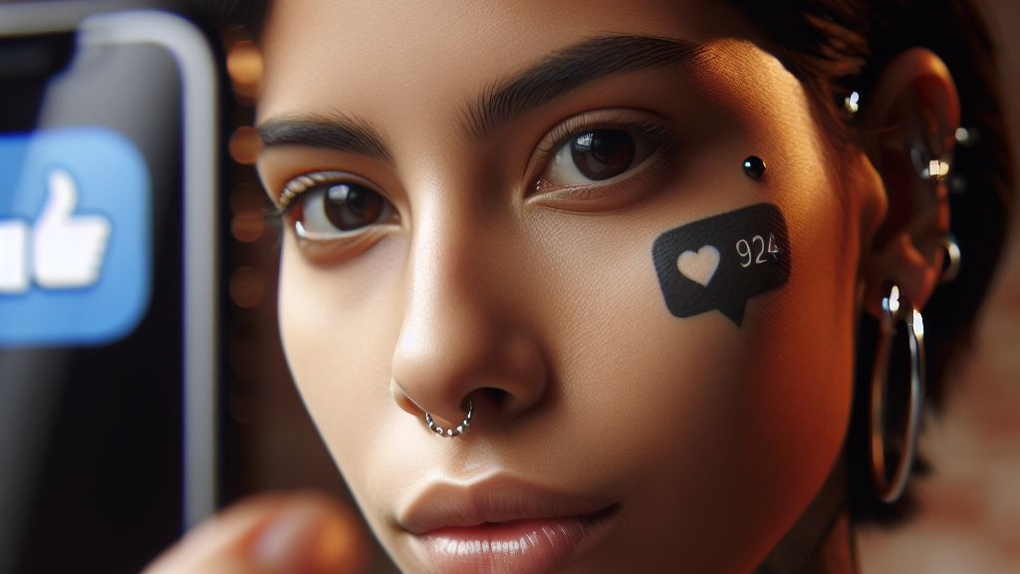
What if…
we just show data right on the people we talk to?

Slide 5
Some Examples of such Body-Based Visualization

Slide 6
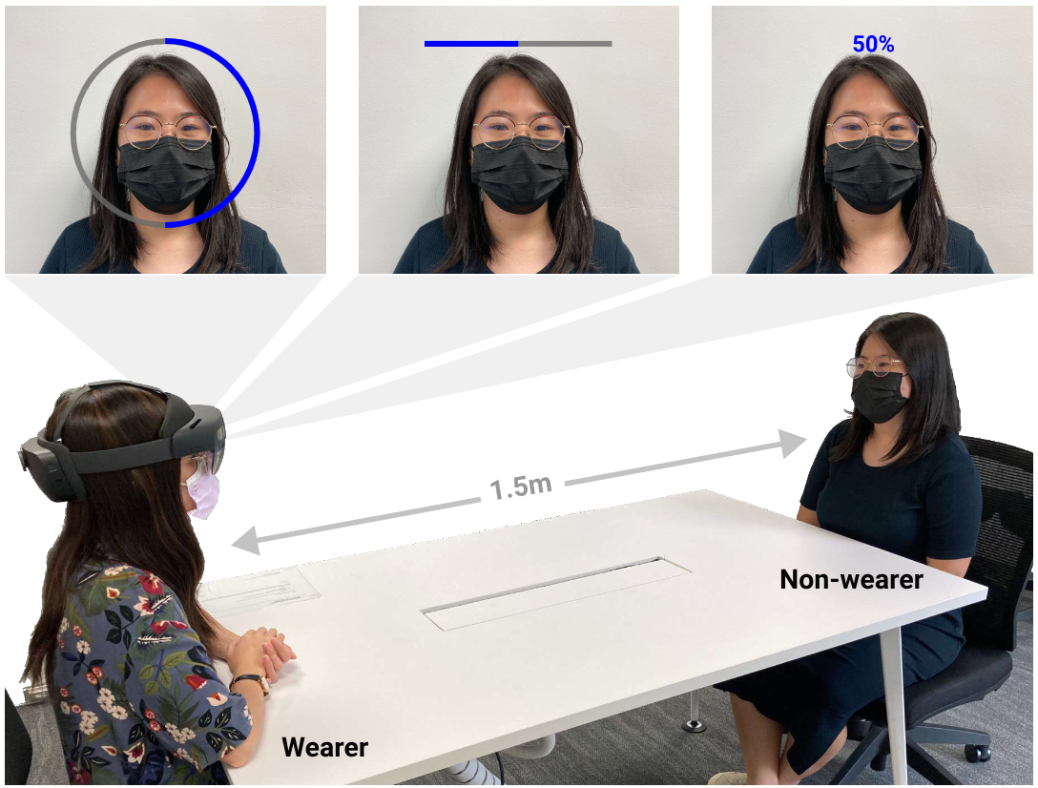
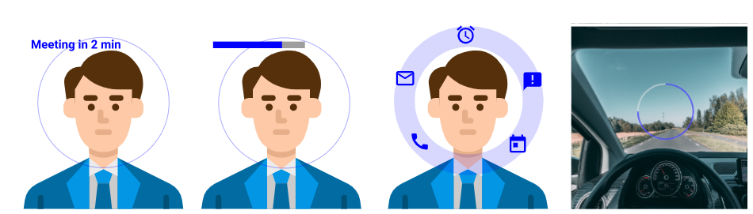
Paracentral visualizations
Janaka et al., 2022
Notes:
https://dl.acm.org/doi/10.1145/3491102.3502127

Slide 7
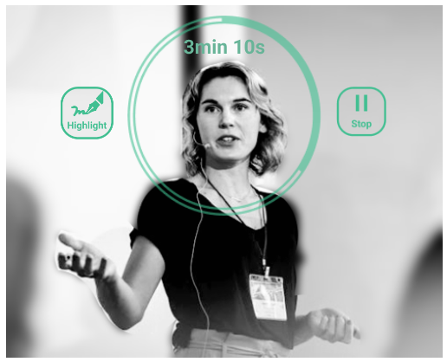
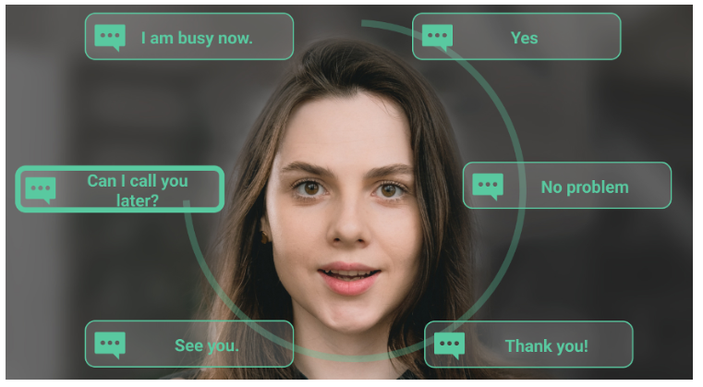
Paracentral menus
Cai et al., 2023
Notes:
https://dl.acm.org/doi/10.1145/3544548.3581065

Slide 8
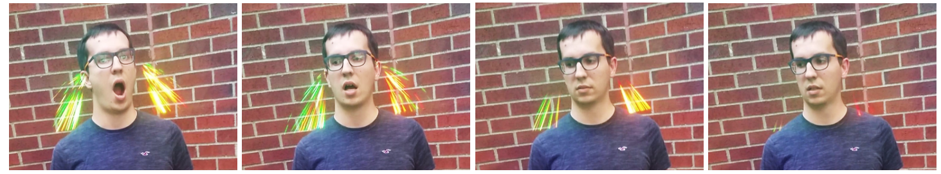
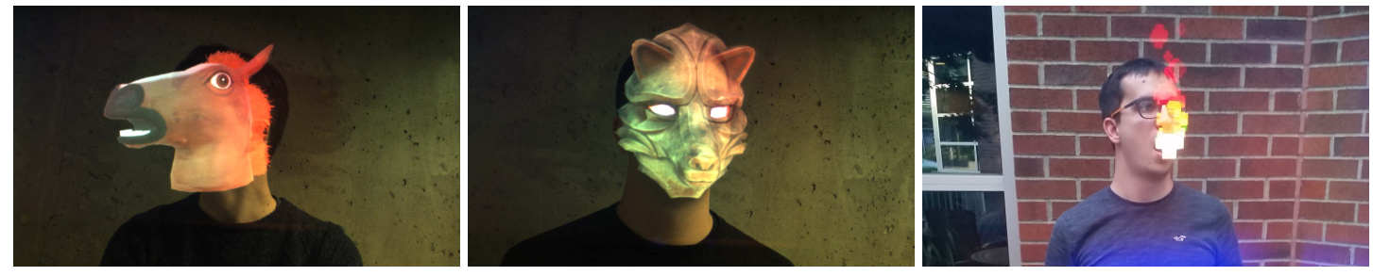
Augmenting human-to-human interactions
Kowalski et al., 2018
Notes:
HoloFace: https://ieeexplore.ieee.org/abstract/document/8354126

Slide 9
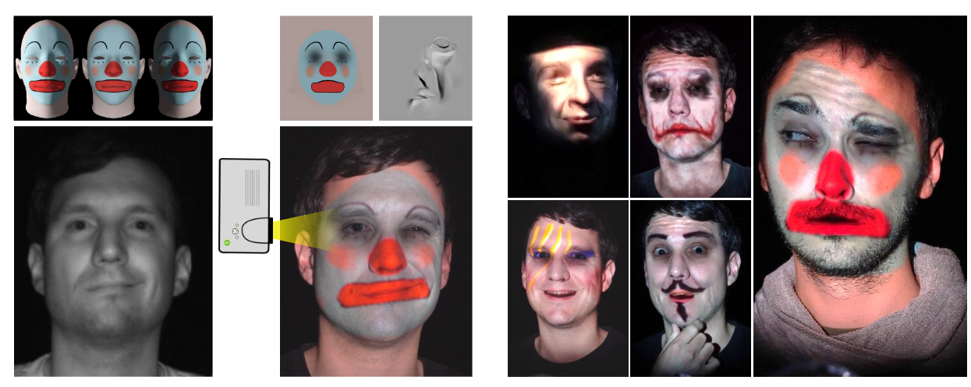
Augmenting faces with projection
Bermano et al., 2017
Notes:
https://onlinelibrary.wiley.com/doi/full/10.1111/cgf.13128

Slide 10
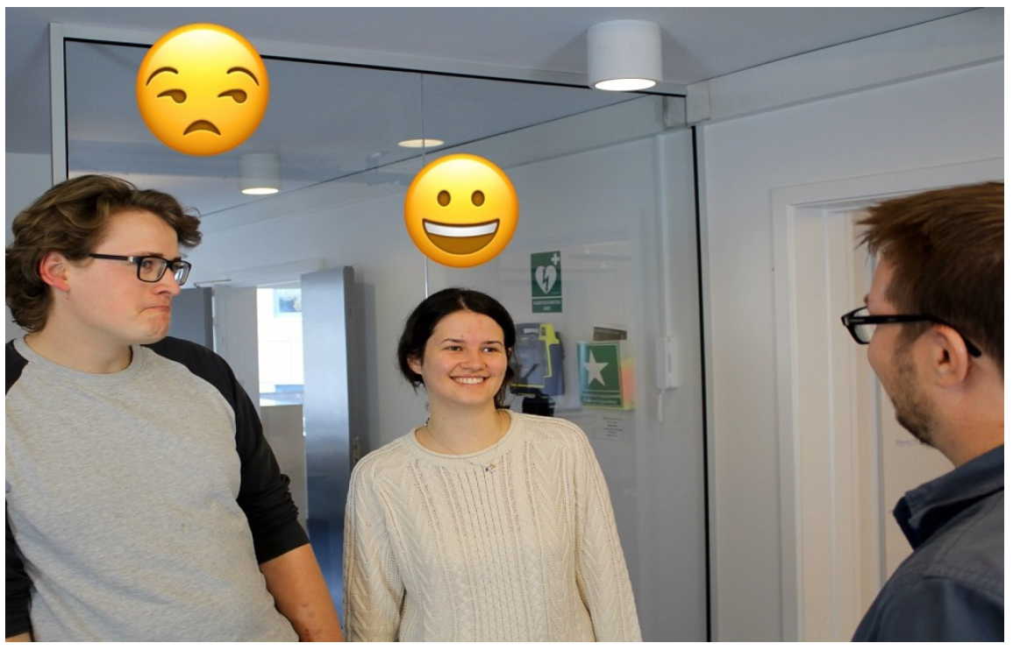
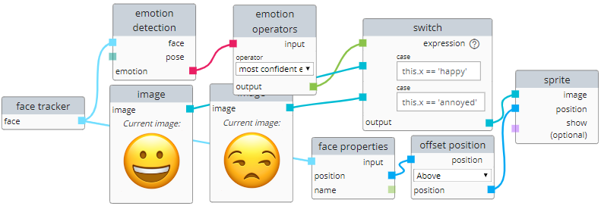
Developing body-based AR
Pohl et al., 2020
Notes:
https://dl.acm.org/doi/abs/10.1145/3385956.3418946

Slide 11
Design Space for Body-Based Visualization

Slide 12
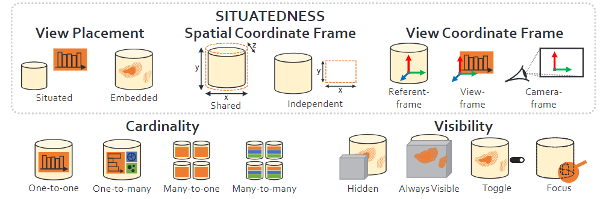
Related design spaces
Situated Visualization in AR, Lee et al., 2024
Notes:
https://ieeexplore.ieee.org/document/10297565

Slide 13
Related design spaces
Visual variables from Bertin’s Semiology of Graphics, 1983
Notes:
https://ieeexplore.ieee.org/document/10297565

Slide 14
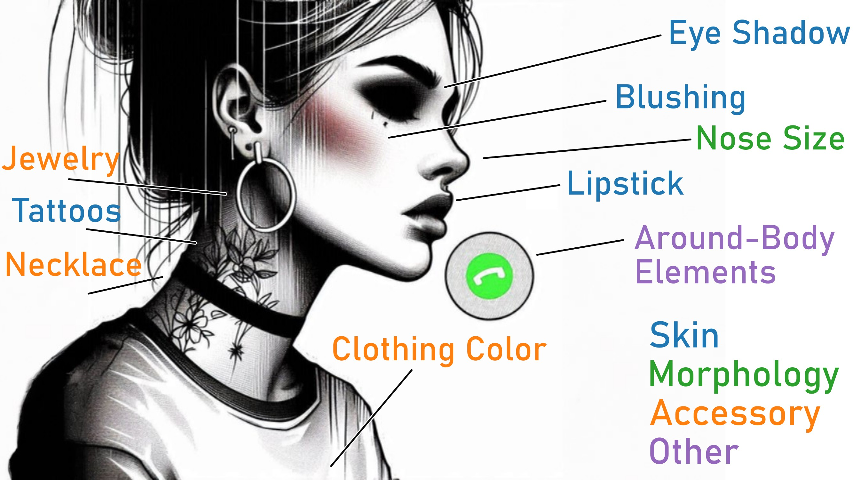
Overview

Slide 15

Skin augmentation
Notes:
https://www.pexels.com/photo/woman-in-white-button-up-long-sleeve-shirt-doing-makeup-6877447/

Slide 16

Skin augmentation
Notes:
https://www.pexels.com/photo/young-man-with-tattoos-and-sunglasses-11683538/

Slide 17

Skin augmentation
Notes:
https://www.pexels.com/photo/a-man-in-brown-coat-with-abc-letters-painted-on-face-7335409/

Slide 18

Skin augmentation
Notes:
https://www.pexels.com/photo/portrait-of-brunette-woman-with-glitters-26903356/

Slide 19
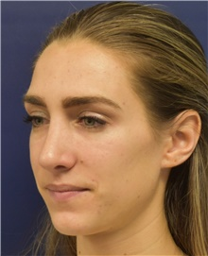
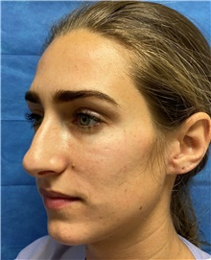
Morphology augmentation
https://www.plasticsurgery.org/photo-gallery/procedure/rhinoplasty/case/43474
Notes:
https://www.plasticsurgery.org/photo-gallery/procedure/rhinoplasty/case/43474

Slide 20
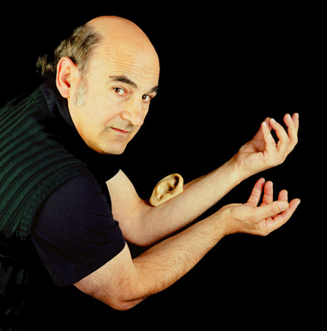
Morphology augmentation
Stelarc, 2008
Notes:
http://stelarc.org/_activity-20242.php

Slide 21
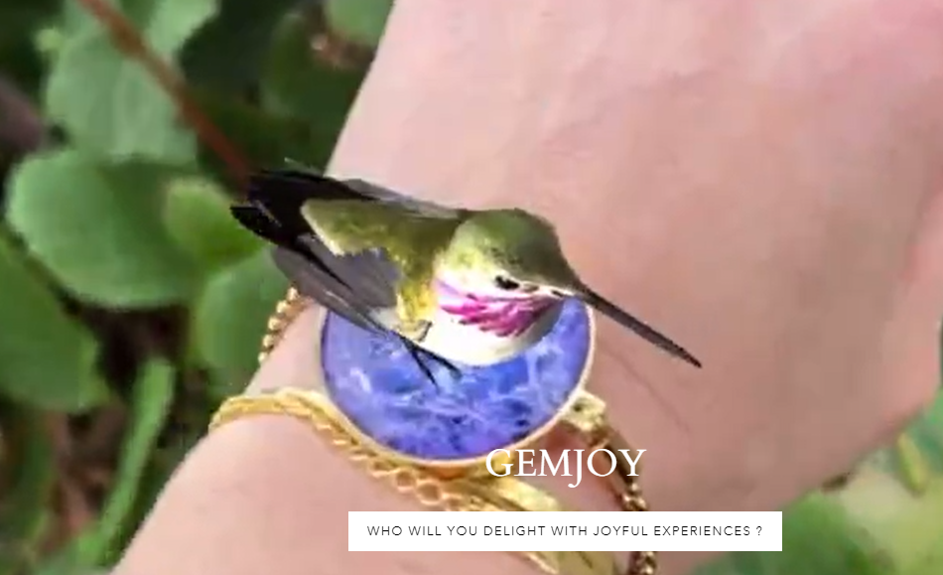
Accessory augmentation
Notes:
https://gemjoy.com/

Slide 22
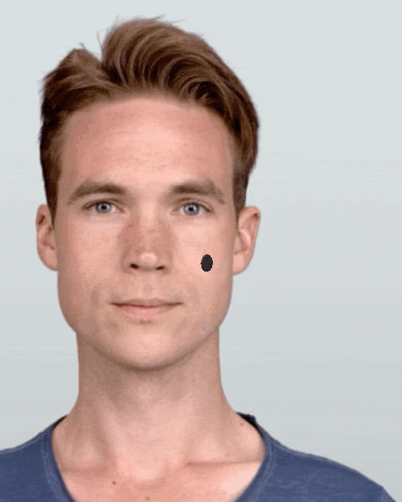
Body-based is not just on-body

Slide 23
Prototype

Slide 24
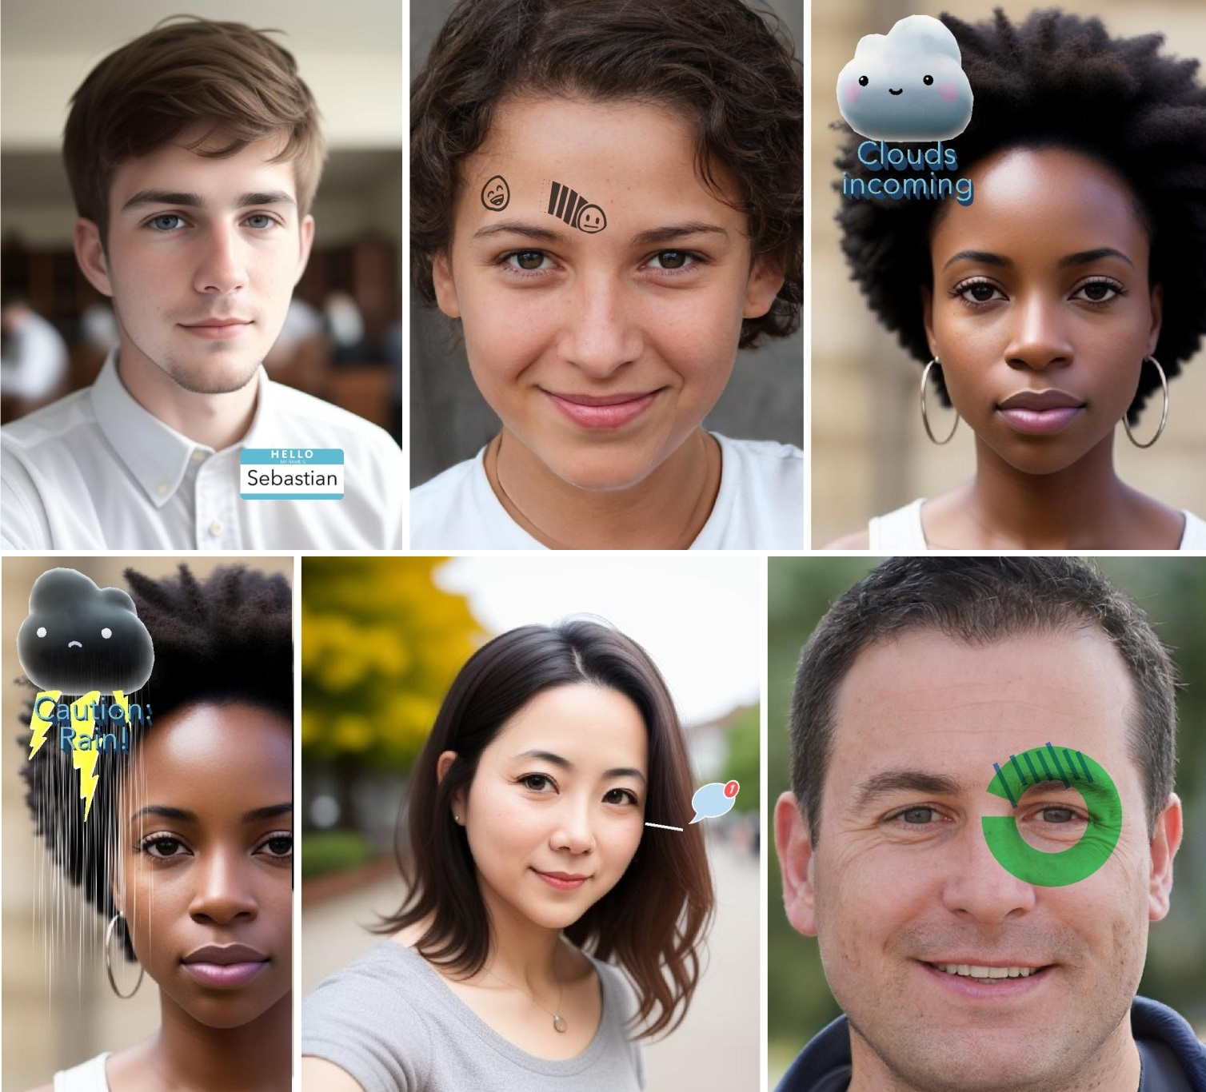
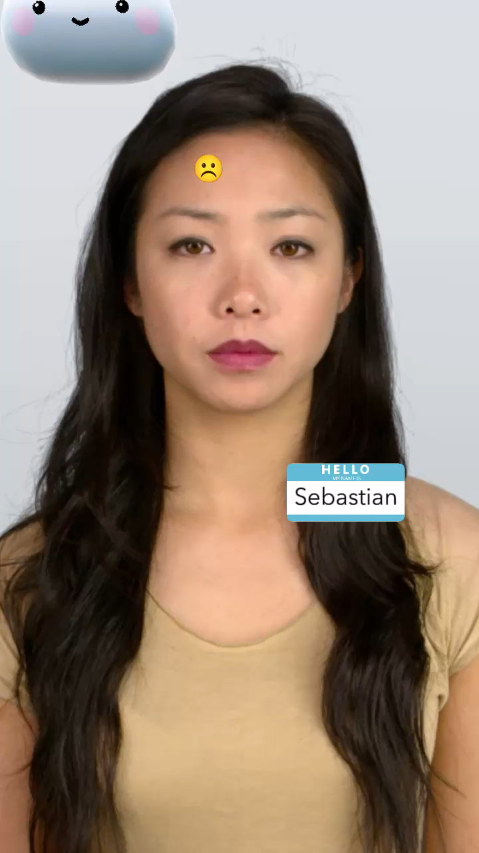
Overview
Five augmentations for conversations
Covering range of visualiza- tion types
Imple- mented as Snap- chat lens

Slide 25
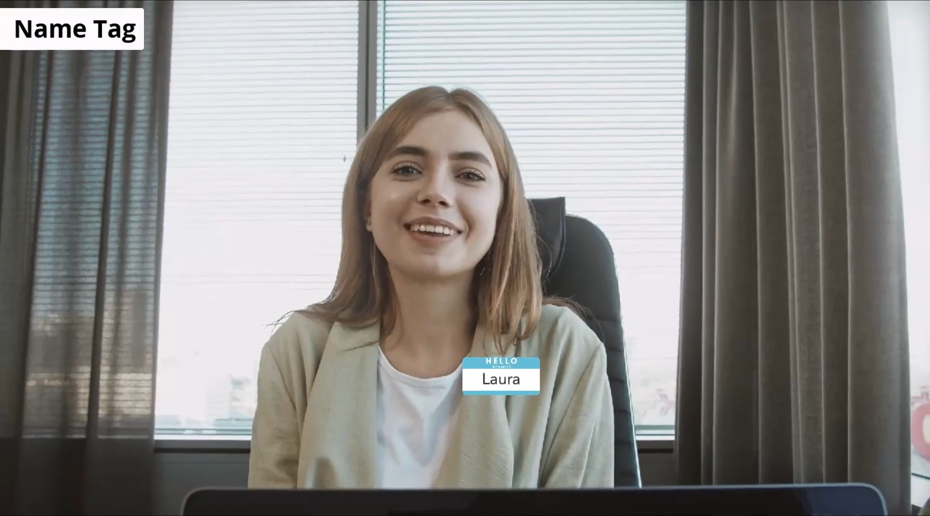
Helping to remember names

Slide 26
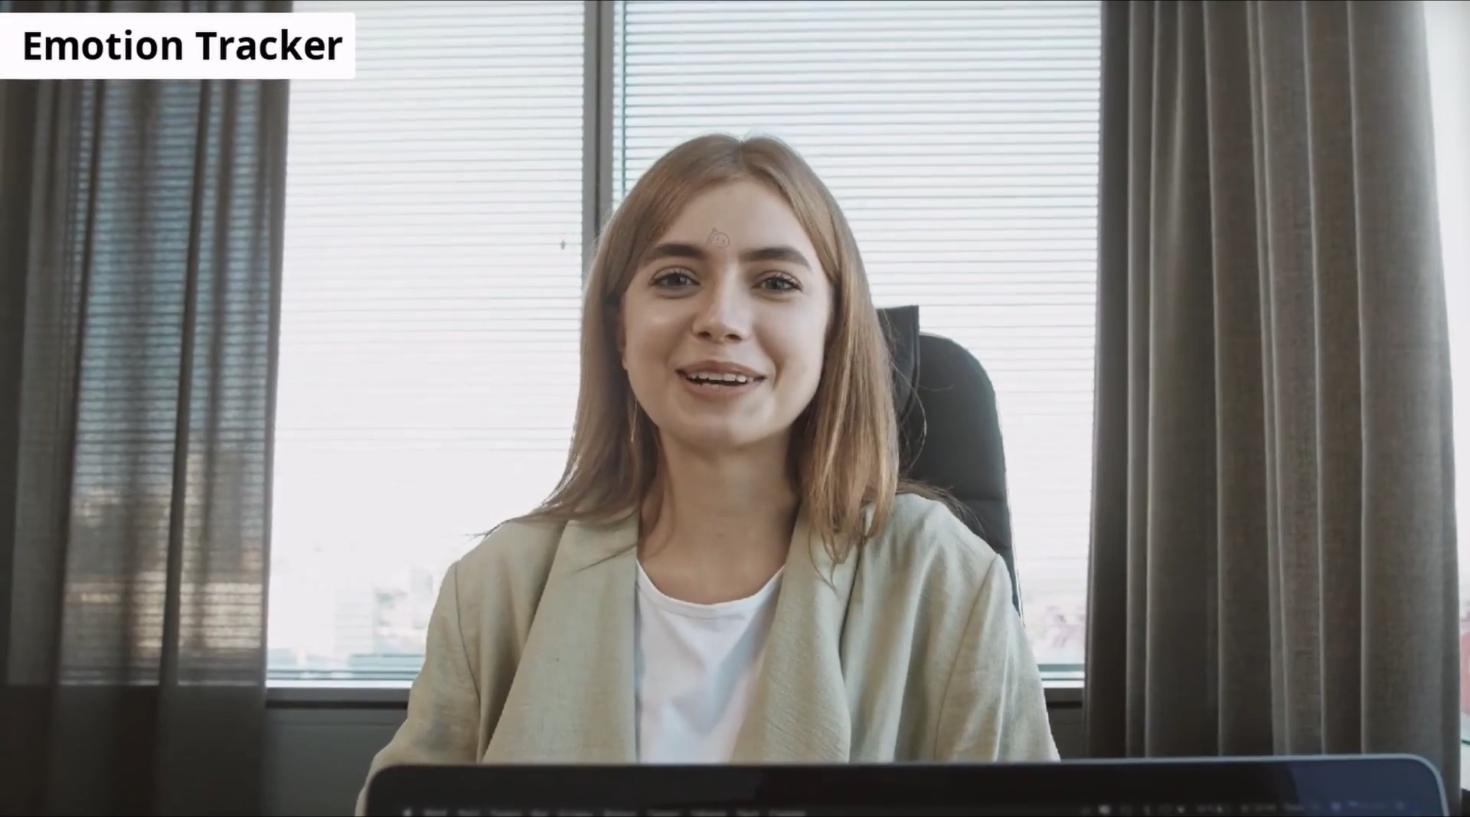
How is the other person’s mood?

Slide 27
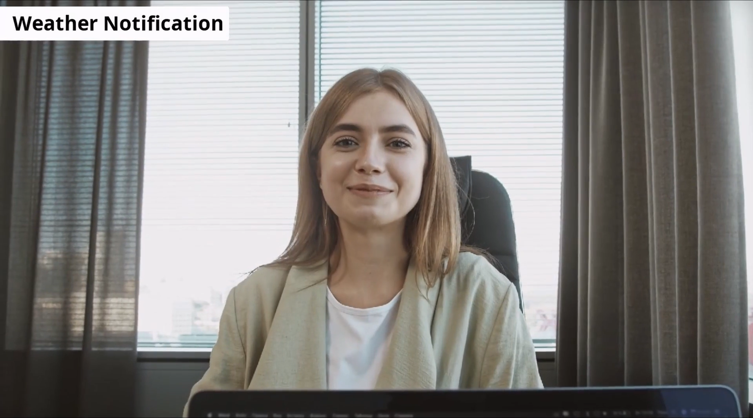
Alerts for changing weather

Slide 28
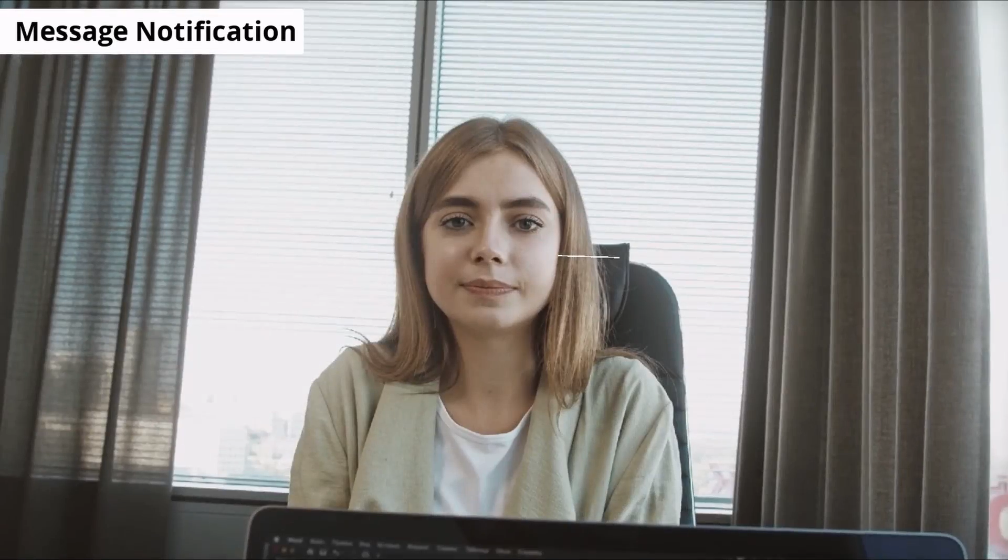
Alerts for incoming messages

Slide 29


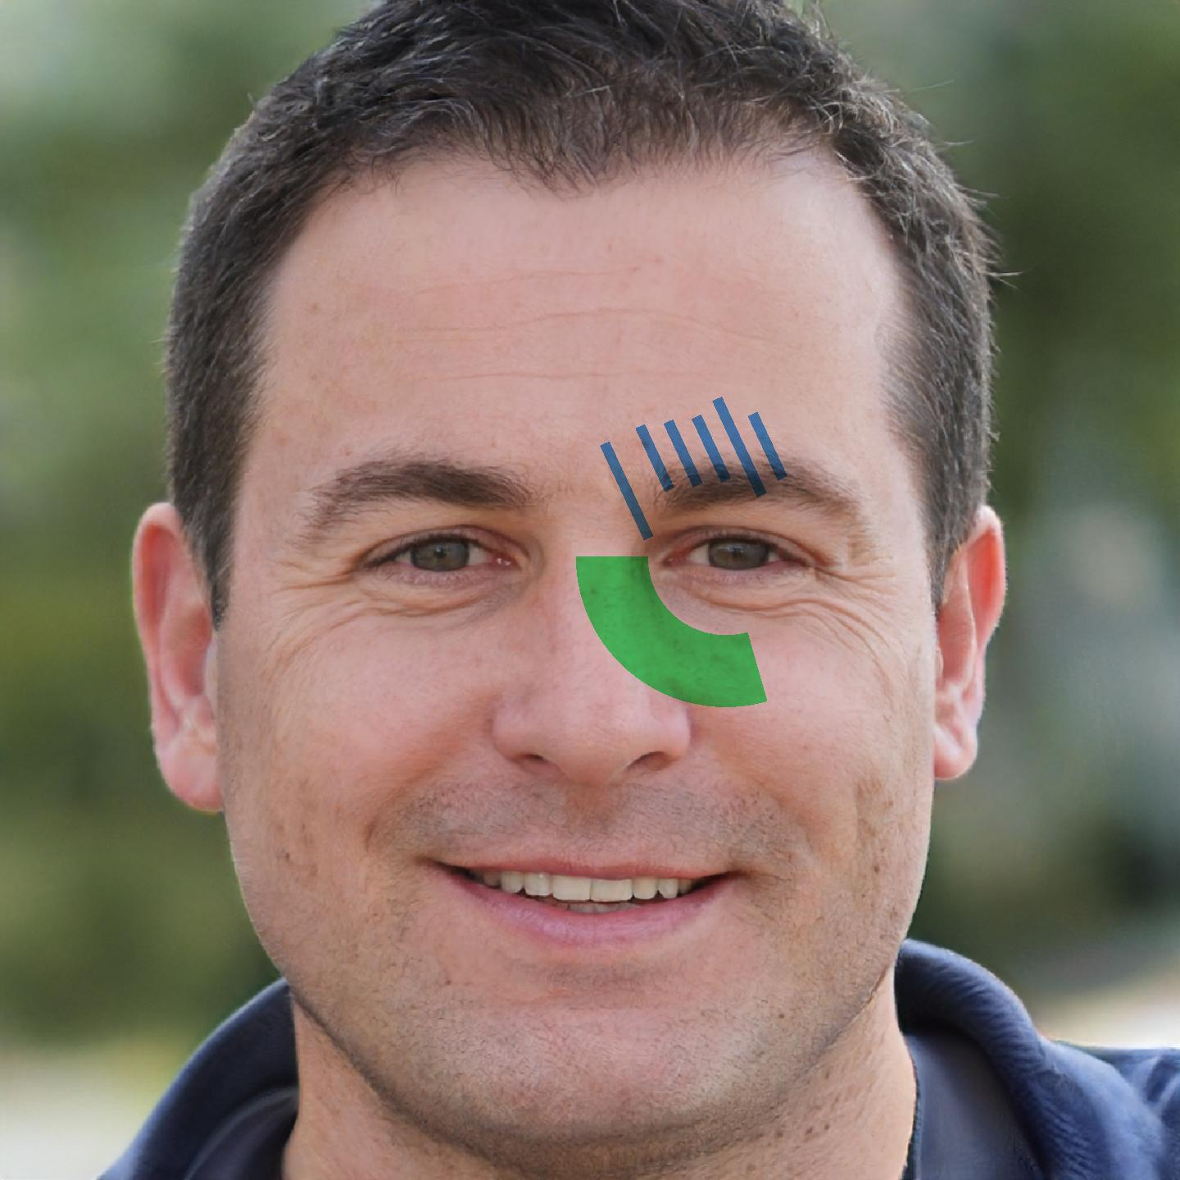
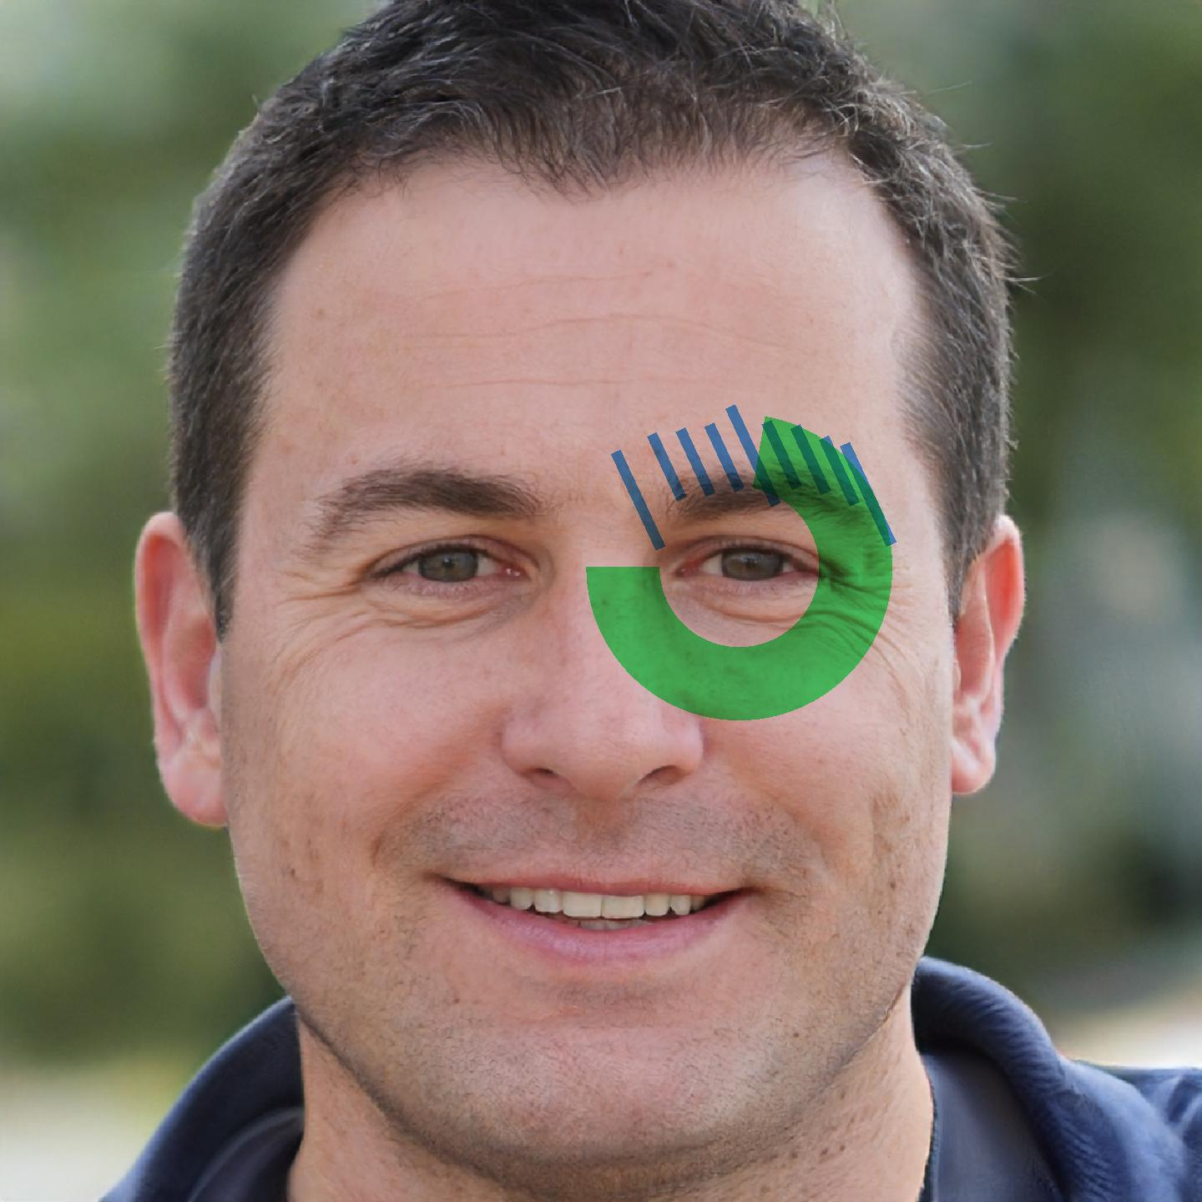
How long has this chat been?

Slide 30
Evaluation

Slide 31
Goals
What happens to conversations when such augmentations are used?
Do they just disrupt the conversation?
Can people keep their attention on the other person?
Is something like this socially acceptable?
Furthermore: How do people like the different visualizations?
Could they be useful or would they just be distracting?

Slide 32
Design
Casual conversations with 16 participants (9F, 7M) from Prolific
Conducted via Snapchat and with a confederate
Participants see the visualizations on the confederate
Visualizations appear/disappear over time, with some fuzziness:
Post-chat questionnaire, chat itself is not analyzed

Slide 33
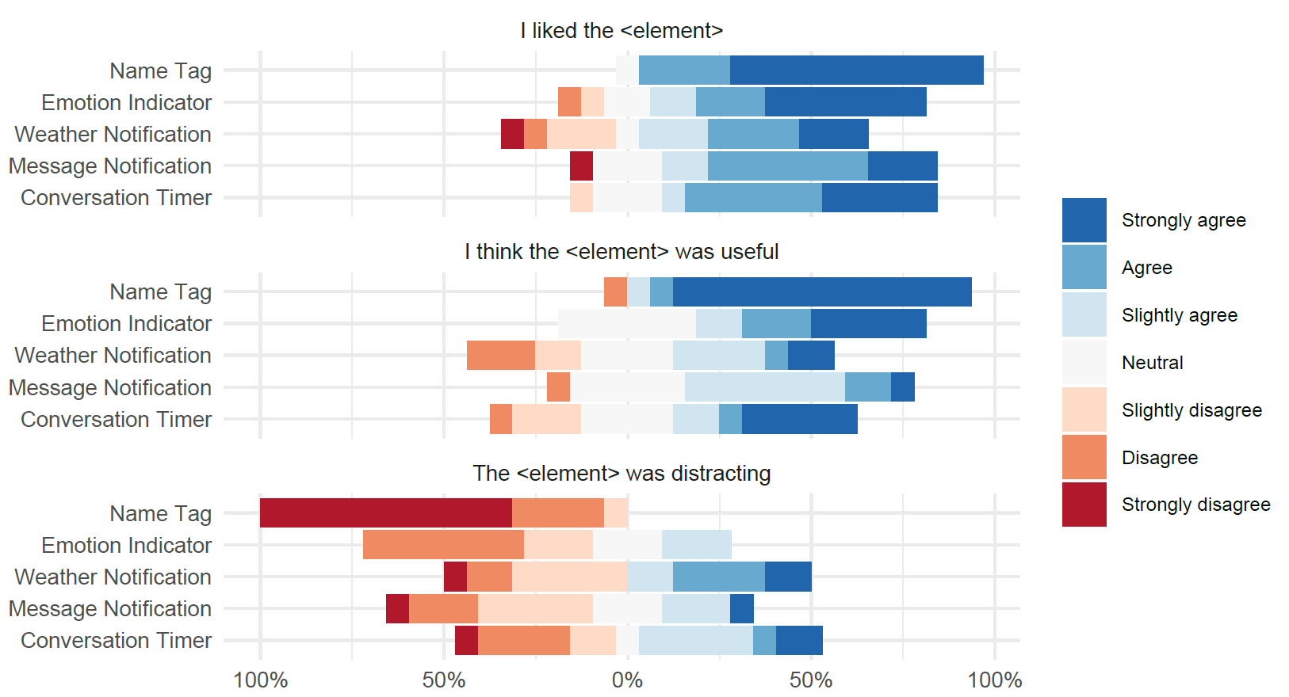
How people rated the visualizations

Slide 34
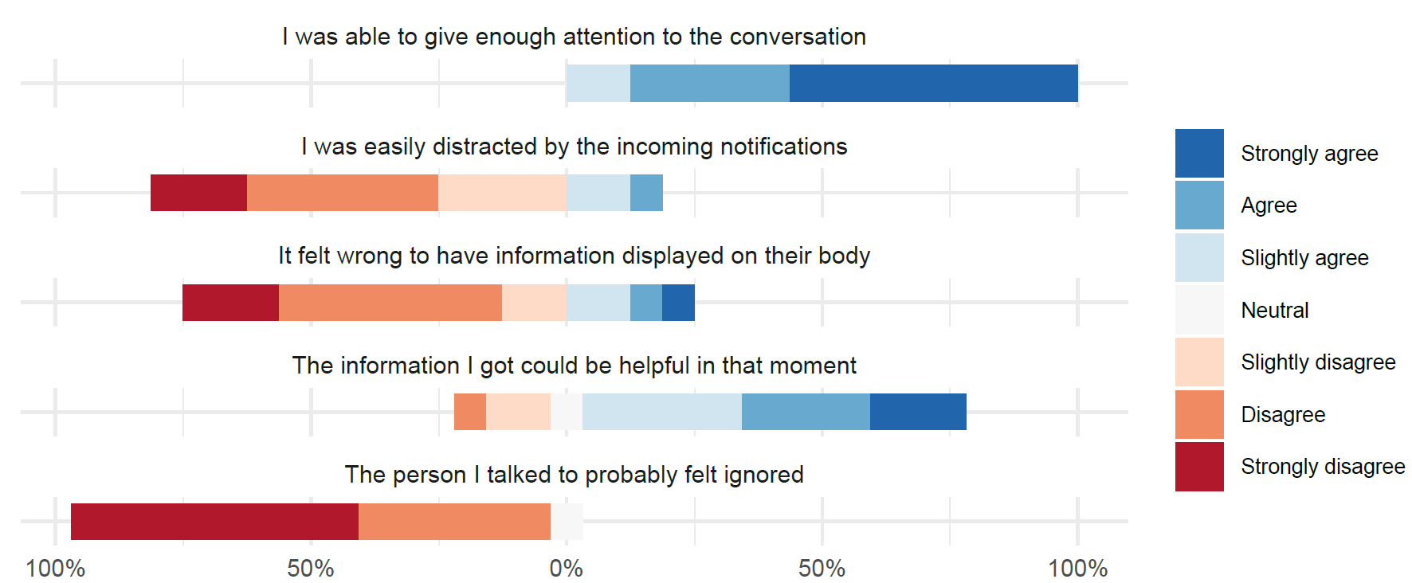
How about the interaction overall?

Slide 35
Participants’ comments
On the effects on the conversations:
“I feel the visualizations were rather helpful/informative and I never felt any distractions” (P11)
“I feel the video call was a bit too much, in terms of the visualizations, they were a bit distractive but I was able to keep up with the conversation.” (P6)

Slide 36
Participants’ comments
On the effects on the conversations:
“I really didn't mind having them on the screen, it's good to know how the other person is feeling and the timer also it helped with keeping our time.” (P12)
“The name tag was great so you don't have to make the person feel bad if you forgot their name.” (P13)

Slide 37
Participants’ comments
Potential improvements:
“Put it on the side, not on their face” (P8)
How it was, was perfect. I just would change the position of timer.” (P1)

Slide 38
Participants’ final remarks
“I liked the effects on the conversation, the effects were not distracting at all.” (P7)
“It was a great experience. I would like to see some of these tools available in the future.” (P13)

Slide 39
Summary
There’s a large design space for body-based visualizations
They can provide helpful information during conversations
Users did not feel they negatively impacted the conversations
Contact:
henning@cs.aau.dk
@henningpohl

